Slide 1
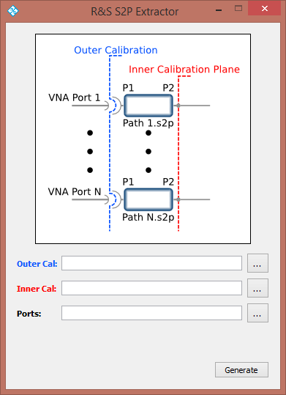
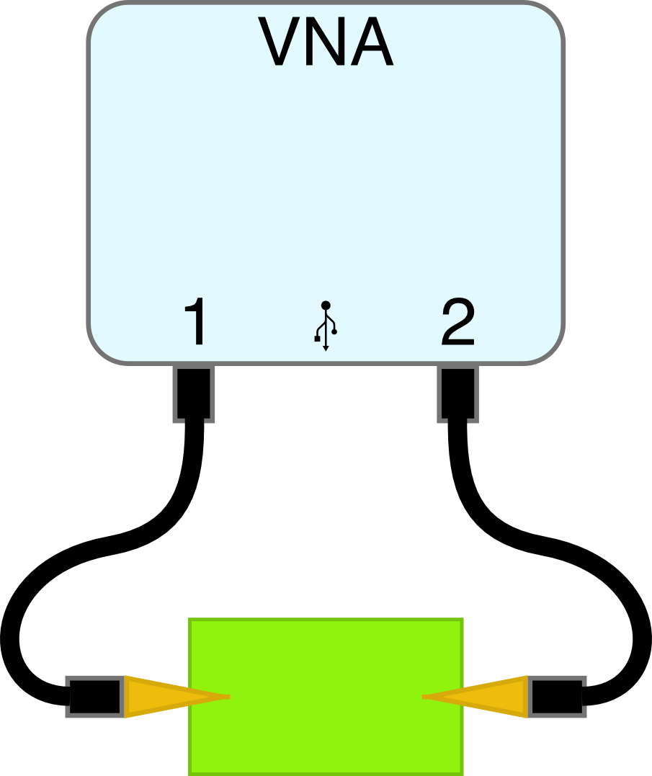
R&S S2P Extractor
Perform two specific calibrations to characterize devices without connectors
Probe tips
Test fixtures

Slide 2
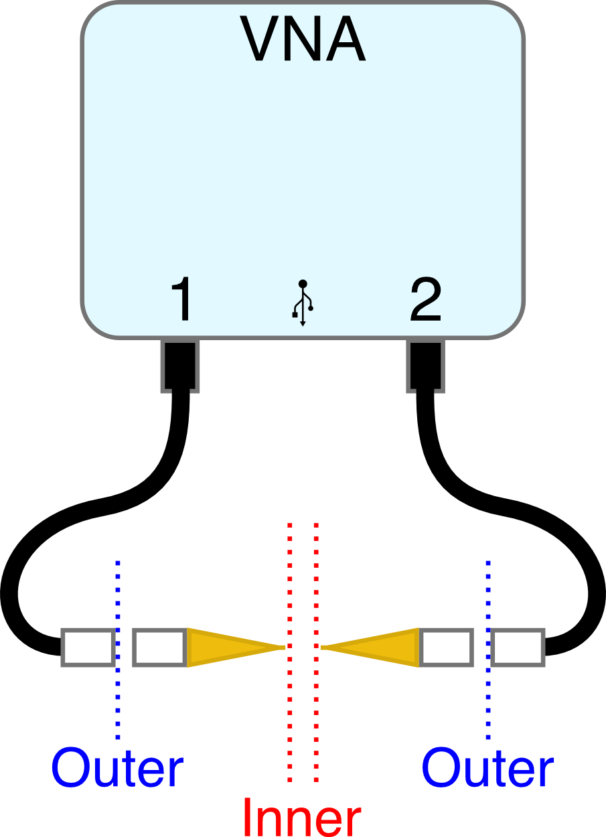
R&S S2P Extractor
Two calibrations:
Outer calibration
Inner calibration (with probe/fixture)

Slide 3
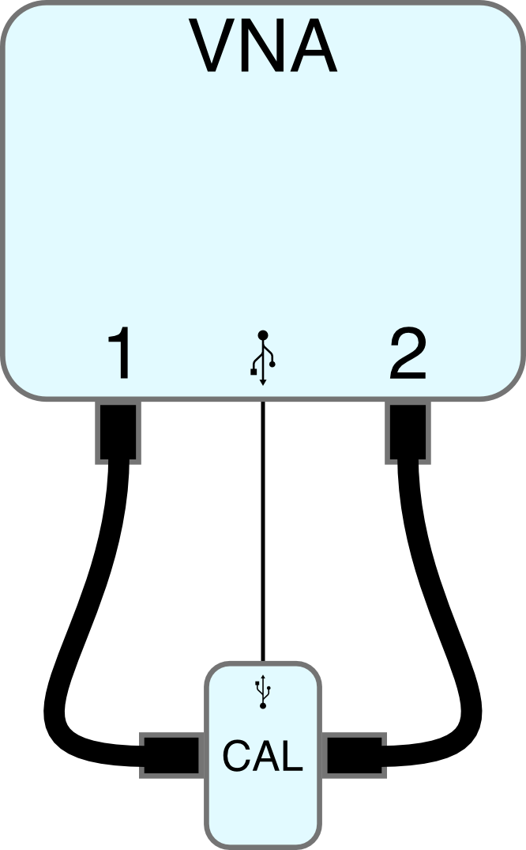
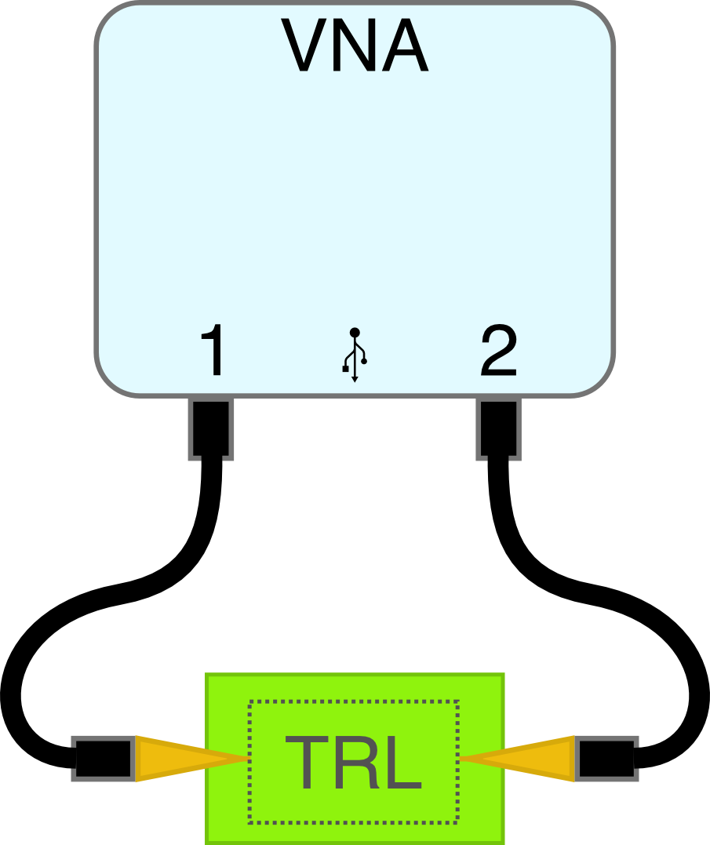
R&S S2P Extractor
Outer calibration is generally UOSM or TOSM to cables
Inner calibration is more complicated (TRL)
Outer Calibration
Inner Calibration

Slide 4
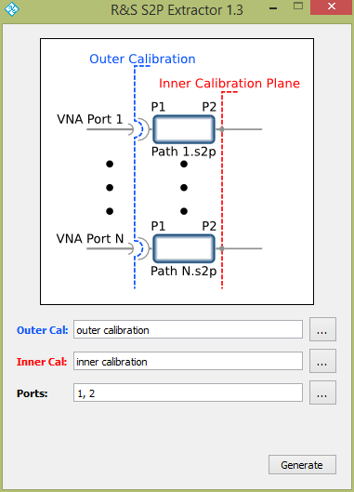
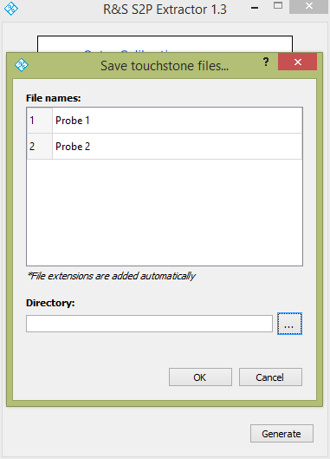
R&S S2P Extractor
Choose outer and inner calibrations
Choose ports to extract
Save .s2p files
Probe 1.s2p
Probe 2.s2p

